Slide 1
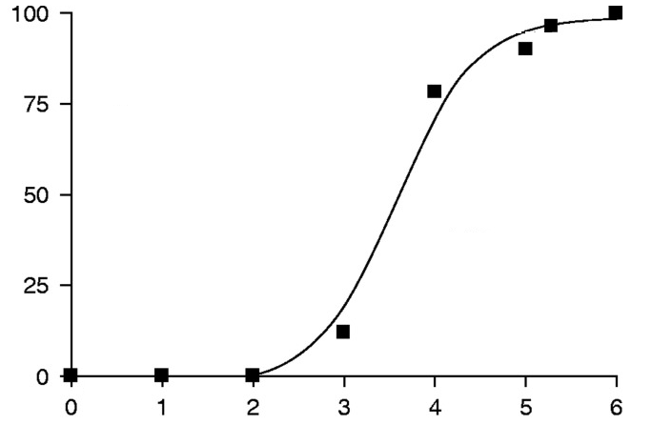
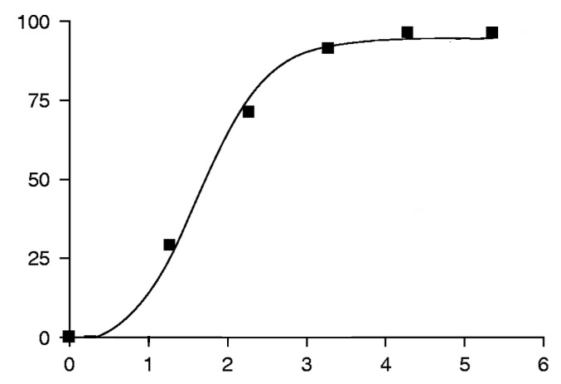
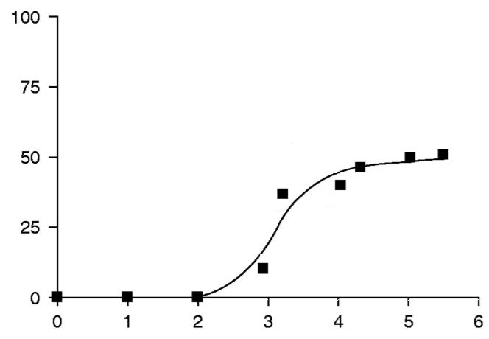
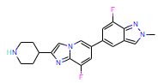
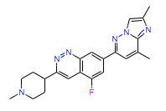
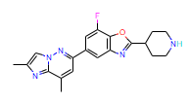
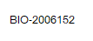
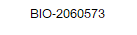
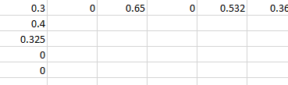
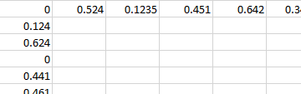
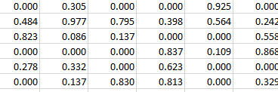
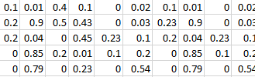
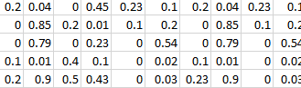
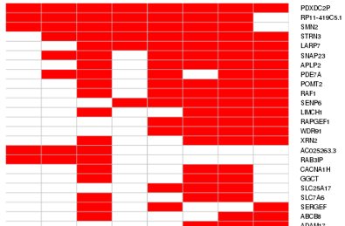
Goal: Construct a database of altered splicing events upon compound treatments, and streamline the process
…
Impact:
Facilitate identification of target genes,
splicing events, and small molecules.
HTT: Branaplam data saved ~6 months.
(3) Streamlined off-target analysis
EC50
Compound Annotation
Structure
Compound
dose1 dose2 dose3
BIO-2062335
Event1
Event2
Event3
Chr5:424821_42581
cell line
GeneA
Chr5:428821_42889
cell line – dose -DMSO
dPSI
dPSI
Chr5:528821_52889
Event4
Event5
…
Ev1 Ev23 … Ev503
GeneB
HTT
dPSI_Ev430
Percent Spliced In (PSI)
BIO1 BIO2 ... BIO48
cell line
Common spliced events
Splicing Annotation
Delta-PSI (dPSI) and p.adj compared to DMSO

Slide 2
Construct a database of altered splicing events upon compound treatments, and streamline the process: Ask
10 compounds, 2 doses: 3 months
3 rounds per year:
months | I |  |  |  | II |  |  |  |  | III
weeks | 1 | 2 | 3 | 4 | 5 | 6 | 7 | 8 | 9 | 10 | 11 | 12
cell culture (NGN2)
cell+compound
RNAseq
data analysis
data ingestion into DB
chemical matter
DB and visualization
FTE | Cost | Notes
1.42 | 162,000 | Total
0.15 | 0 | 0
0.01 | 0 | internal FTE
0.3 | $33,000 | reagent
0.3 | 0 | internal FTE
0.06 | 0 | internal FTE
0.1 | $9,000 | all around the year, outsourced
0.5 | $120,000 | Outsourced, <1 year remaining out of 1.5
100 compounds, 2 doses: 5 months
1 round per year:
months | I |  |  |  | II |  |  |  |  | III |  |  |  | IV |  |  |  | V
weeks | 1 | 2 | 3 | 4 | 5 | 6 | 7 | 8 | 9 | 10 | 11 | 12 | 13 | 14 | 15 | 16 | 17 | 18
cell culture (NGN2)
cell+compound
RNAseq
data analysis
data ingestion into DB
chemical matter
DB and visualization
FTE | Cost | Notes
1.54 | 250000 | Total
0.1 | 0 | 0
0.01 | 0 | internal FTE
0.2 | $85,000 | reagent
0.2 | 0 | internal FTE
0.03 | 0 | internal FTE
0.5 | $45,000 | as above
0.5 | $120,000 | as above

Slide 3
Construct a database of altered splicing events upon compound treatments, and streamline the process: Ask – supplementary slide
compound per run |  |  |  |  |  |  |  | Request | 100 compounds per run
 | current | 10 compounds per run | 2 doses |  |  |  |  | 2 doses
 | actual time | hands-on time FTE in days | FTE per year per run | per year (3x runs) | reagent/budget |  |  | source cell culture |  | 75000000 | cell | 2 dose, triplicate per compound
 |  |  |  |  |  |  |  | actual time | hands-on time | misc | FTE | reagent
cell culture (NGN2) | 4 weeks | 2 | 0.04 | 0.12 |  |  | cell culture (NGN2) | 5wk | 1wk | 75M cells |  |  | > Ask Sandi
chemical matter | 3 weeks | 2 weeks | 0 | 0.1 | $9,000 |  | chemical matter | 20wk | 20wk | 0 | 0.5 | $45,000 | (if outsourced)
cell+compound |  |  |  |  |  |  | cell+compound |  | 3days
RNAseq | 1 week | 4 | 0.1 | 0.3 | $63,000 |  | RNAseq | 4wk | 2wk |  |  | $85,000
data analysis | 3 weeks | 5 | 0.1 | 0.3 | internal |  | data analysis | 4wk | 3wk |  |  | internal
construction of database and visualziation platform | 1.5 years | 25 | 0.5 | 0.5 | $120,000 |  | construction of database and visualziation platform | 0 | 0 | 0 | 0 | done
data ingestion into DB | 1 week | 1 | 0.02 | 0.06 | internal |  | data ingestion into DB | 2wk | 2wk |  |  | internal
total |  |  | 0.76 |  |  |  | total
start to finish per run | 12 weeks |  | 0.76 | 1.38 |  |  | start to finish per run | 15wk
 |  |  | JH> for RASLseq .. Also plot Dose-response (ask BSSI)
 |  |  | parallel approac for BSSI RASLseq and Zhen's catching up.
 |  |  |  |  |  |  |  | 600 | samples |  |  | $3600/plate
 |  |  |  | 2 plates, 50M fragments : ~$21k (libprep and sequencing)

Slide 4
Focusing capabilities for potential buildout
Effort: Impact -> | Target ID | Site ID | SM Hit ID | SM Opt/Safety | MOA | Benefit from addtnl investmnt | Timeline to impact | First pass prioritization | Sub-team for deep dive into what build would look like
Target prioritization framework | X | X |  |  |  |  | I |  | All
Transcriptomic dataset generation/analysis | X | X | X | X | X |  | L | High | Dann, Thomas, James, Jessica
Database for splicing data integration: Query by Cmpd/Target/Structure | X | X | X | X | X |  | L | High
Comp. RNA structural methods (e.g. Nymirum) | X | X | X | X | X |  | I | High | Linlong, Kevin, James, Govinda
Biophys. def of RNA:protein:SM interactions |  |  |  | X | X |  | I
HT Splicing Assays (e.g. RASL-seq) | X | X | X | X |  |  | I | High | Jessica, Joon, Catherine
Artificial splicing factors | X | X |  |  |  |  | I
HT qPCR platform |  |  | X | X |  |  | I |  | Mei, James, Jessica, Catherine
Chemical matter buildout (increased diversity) |  |  | X | X |  |  | I | High | James, Simone
SM:protein/RNA ChemBio |  |  |  |  | X |  | M |  | Kurt, James
Safety -> Selectivity understanding |  |  |  | X |  |  | I | High | Colin, Jessica, James, Kevin
Other?
Some already underway. What would we want to highlight as needing additional investment?
I = immediate. M = mid. L = long-term

